Slide 1
Kaiba Corp. EE Capstone 2014
Alyanna Castillo
Patrick Ma
Ryan McDaniel

Slide 2
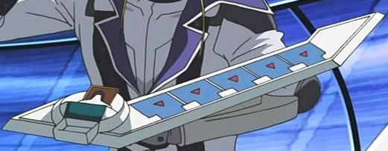
Project vision
Problems:
Design a complete embedded capstone
Must have at least 60% hardware components
Children looking for entertainment
Teach children
Our solution:
Build an RFID compatible learning device
Plays educational and entertainment games

Slide 3
Capstone Deliverables
One working prototype system
Documentation
Another working prototype system (hopefully)

Slide 4
System Requirements
Read multiple RFID tags
Physically react to placed cards
Display data on cards /or players
Communicate wirelessly on multiple frequencies
Interact with user and respond to user input
Track game progress and display relevant game information
Manipulate game data
Maintain a database of cards
Run fast enough to provide “real-time” user experience

Slide 5
Specifications
Operate under normal household conditions
Compliant with EIA-232, ISO15693, I2C, FCC Part 15.A,C standards
Frequency in the 2.4 GHz range for wireless communication with Xbee modules
Withstand children

Slide 6
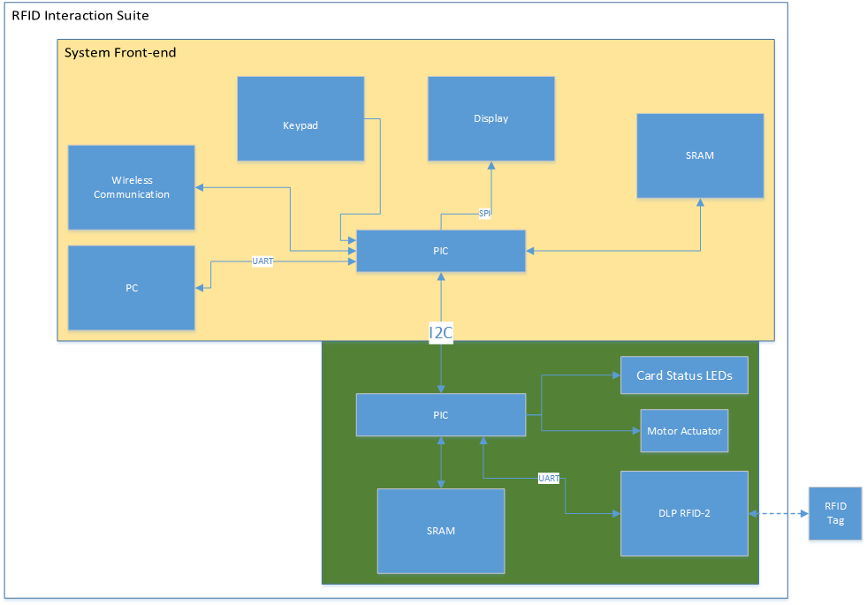
Our Idea: Hardware

Slide 7
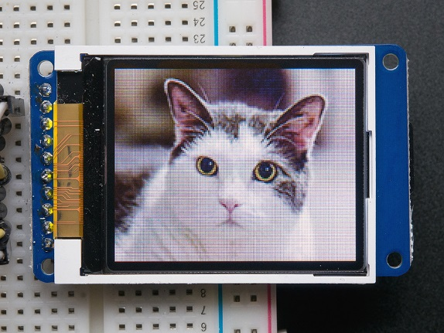
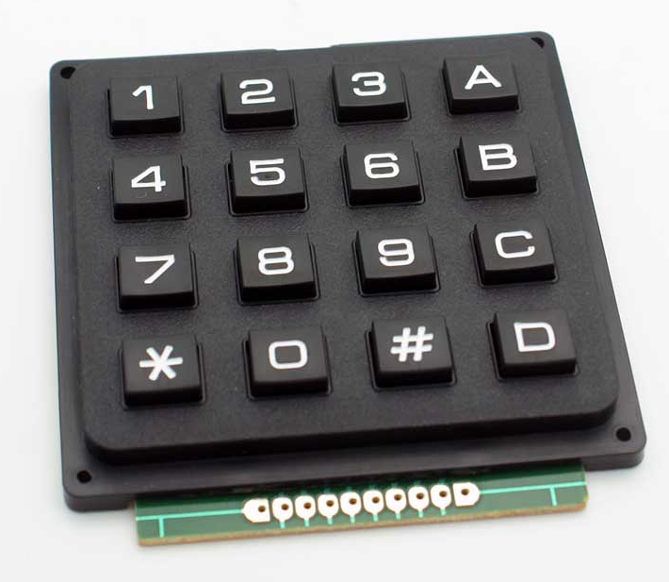
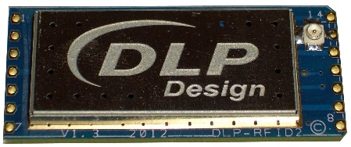
Hardware summary
Components (single system):
RFID Reader/Writer
XBee 802.11.4
(2) GAL22V10
(2) PIC18F46K22
(2) 2k 8-bit SRAM
16-key keypad
128 x 160 Color LCD
3.3v regulator
(4) switches
H-bridge
Linear servo
20MHz Crystal Oscillator
CMOS hex buffer (non-inverting)
(3) RGB LEDs

Slide 8
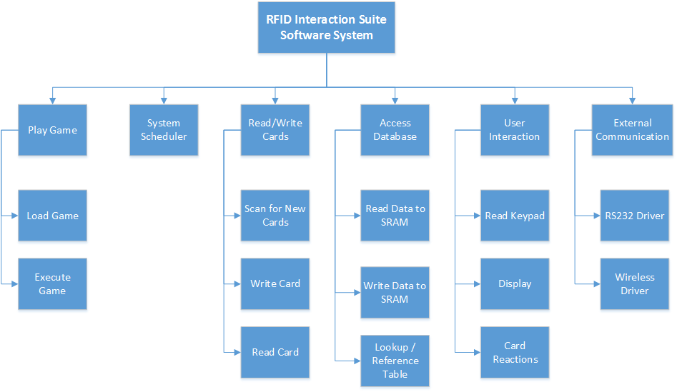
Software functions

Slide 9
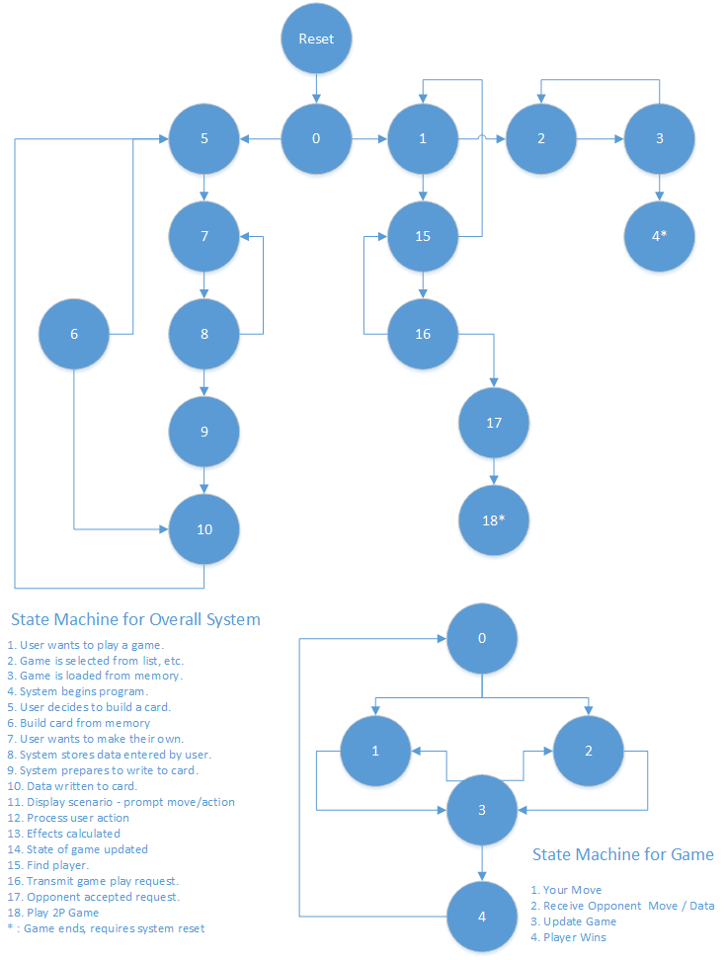
State machines
Basic system flow
Generic game flow

Slide 10
Issues Encountered
Lack of memory + pins
Solution: switched to larger chip from same family
PIC18F46K22
36 GPIO pins
Solution: use a two-level system (frontend + backend)
UART ISR overflow
Occurred when reading RFID tags
Limited to specific functions
Root cause:
excessive context switch lag time
Solution:
remove function calls within ISR
Instruct Compiler to not save data

Slide 11
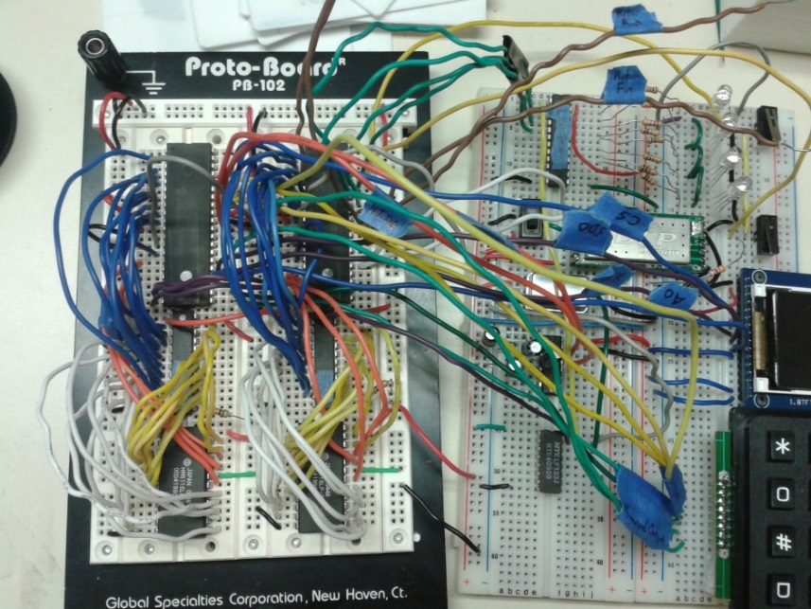
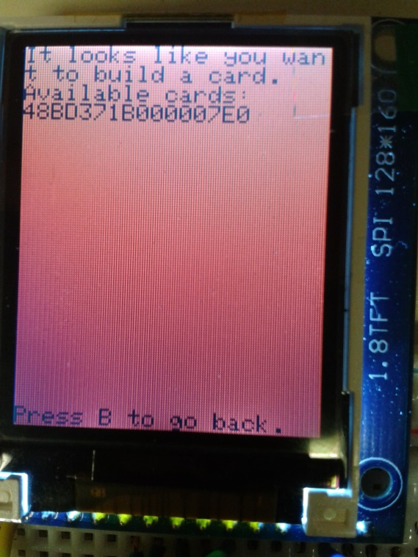
Status
Most hardware modules tested/working separately
Integrating software drivers with scheduler
Currently building game / test software with following functions:
Single Player Duel
Multiplayer Duel
Card Building
Displays

Slide 12
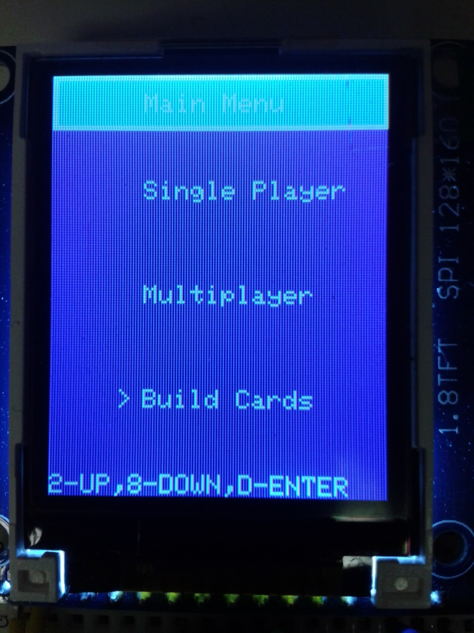
Future work
Implement UX reaction
Integrate to scheduler
XBee / intersystem communication
Implement motor driver
Game loading software

